Slide 1
Dynamic heterostructure文献整理
Owing to the superlubricity of vdW interfaces, moiré superlattices with dynamically controllable twist angles can be obtained through mechanical, optical, thermal, and magnetic manipulation

Slide 2
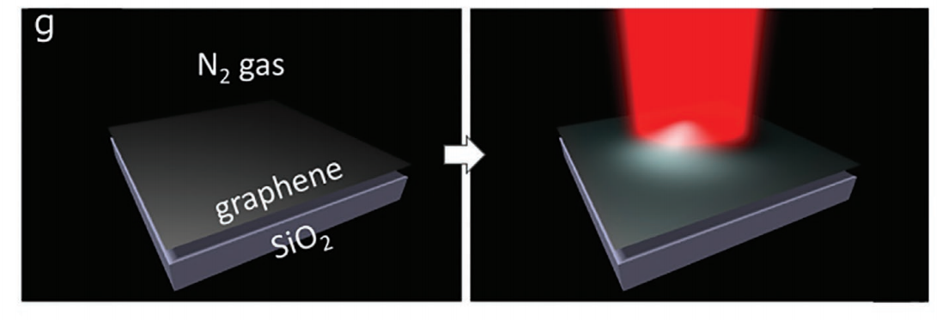
Dynamic heterostructure文献整理
Vogl et al proved that longitudinal waves of light could be used to tune the magic angle of vdW heterostructure, enabling a full control of the rotation angle and phase diagram.

